Slide 1
Introduction to Graphics Programming and its Applications
繪圖程式設計與應用
Practice 2
Instructor: Hung-Kuo Chu
Department of Computer Science
National Tsing Hua University
CS4505

Slide 2
Objective
Get familiar with GLUT
Setup fundamental setting on your own

Slide 3
Hint
In main(int argc, char *argv[]) function
Black : demonstrate in latter slider
white : check practice 1 answer
glutInit(&argc, argv)
Set display mode
Set windows size & position
Create Window
glewInit()
Set GLUT Menu
Register callback function
Main Display loop (Rendering)
Setup reshape function

Slide 4
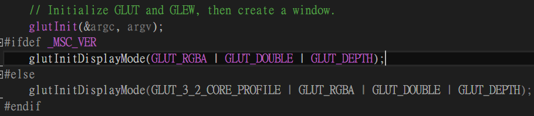
Step – glutinit and set Display Mode
glutInitDisplayMode(usigned int displayMode);
GLUT_RGBA : using 4 channel (in R->G->B->A order) to represent color
GLUT_DOUBLE : using double buffering
GLUT_DEPTH : Enable depth buffer

Slide 5
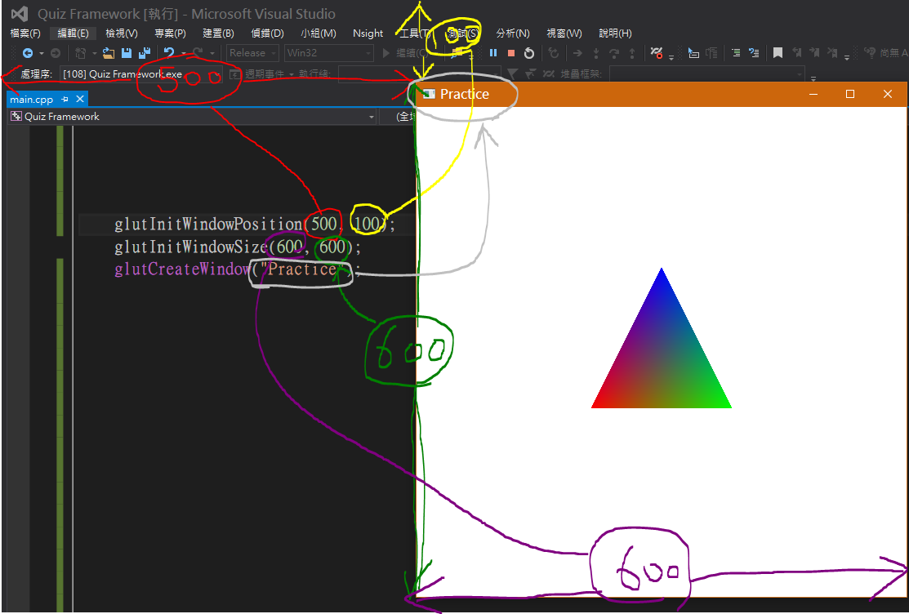
Step – Windows size & position and create window

Slide 6
Step – glewInit()
OpenGL Extension Wrangler Library (GLEW)
After creating window, then call glewInit()
What is GLEW doing?
Not every OS support latest version of OpenGL ( EX. Microsoft windows 10 only support to OpenGL 2.X )
GLEW provides efficient run-time mechanisms for determining which OpenGL extensions are supported on the target platform.
In short, we are able to use latest version of OpenGL ( usually be 4.X) by using GLEW

Slide 7
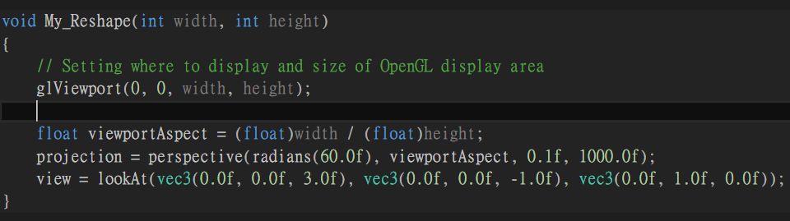
Step – reshape function
Note : My_Reshape() is already registered in main() by calling glutReshapeFunc(My_Reshape);
My_Reshape(int width, int height)
Width, height : current windows size
glViewport(GLint x, GLint y, Glint width, Glint height)
Decide where and how to display OpenGL window on GLUT windows.

Slide 8
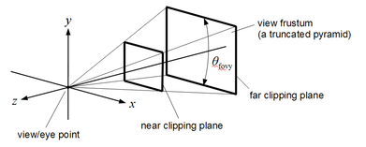
Step – reshape function
glm::Perspective(float fov, float aspect, float nearClipPlane, float farClipPlane)
Building a projection matrix by calling this function
Fov = field of view, we usually set it to 60 degree, which represent most human’s fov.
Aspect = x/y ratio about
nearClipPlane : distance from near clipping plane to eye point
farClipPlane : distance from far clipping plane to eye point

Slide 9
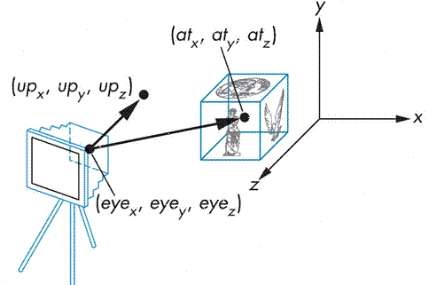
Step – reshape function
glm::lookAt (vec3 cameraPosition ,vec3 cameraLookAt, vec3 cameraUpVector )
cameraPosition : the coordinate of camera position
cameraLookAt : the vector represent which direction does camera look at
cameraUpVector : the vector represent which is the up direction of this camera

Slide 10
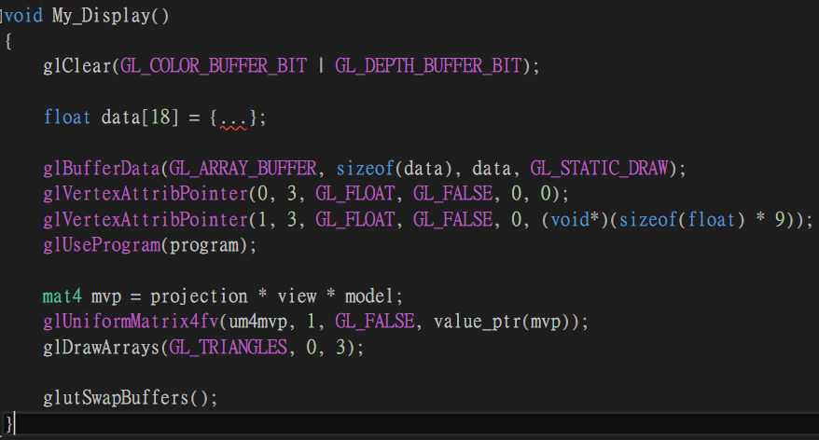
Step – Main display loop (Rendering)
My_Display() is already registered in main() by calling glutDisplayFunc(My_Display);

Slide 11
Step – Main display loop (Rendering)
My_Display() will keep being called by each iteration
Define a timer function by calling glutTimeFunc(My_timer) to control how much time of each iteration
Remember to clear both color and depth buffer by calling glClear(GL_COLOR_BIT_BUFFER_BIT | GL_DEPTH_BUFFER_BIT).
Array of Data[18] here represent a single colored triangle with 3 vertices, and each vertex contains 3 coordinates and 3 colors
Data[0] ~ Data[8] : (x1,y1,z1), (x2,y2,z2), (x3,y3,z3)
Data[9] ~ Data[17] : (r1,g1,b1), (r2,g2,b2), (r3,g3,b3)

Slide 12
Step – Main display loop (Rendering)
glBufferData(GLenum target, GLsizei size, const void* data, Glenum usage)
This api will transfer data to array buffer
https://www.khronos.org/registry/OpenGL-Refpages/gl4/html/glBufferData.xhtml
Target : specifies the target to which the buffer object is bound for glBufferData
GL_ARRAY_BUFFER : intent to use that buffer object for vertex attribute data
Size : specifies the size in bytes of the buffer object's new data store.
Data : specifies a pointer to data that will be copied into data store for initialization
Usage : specifies the expected usage pattern of the data store.
GL_A_B
A = STREAM / STATIC / DYNAMIC
B = DRAW / READ / COPY
GL_STATIC_DRAW : This data will be used as source for GL drawing and the data store contents will be modified once and used many times

Slide 13
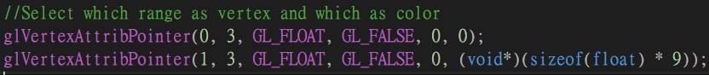
Step – Main display loop (Rendering)
glVertexAttribPointer(GLuint index, GLint size, GLenum type, GLboolean normalized, GLsizei stride, const GLvoid *pointer);
define an array of generic vertex attribute data
Index : Specifies the index of the generic vertex attribute to be modified.
Size : specifies the number of components per generic vertex attribute data, must be 1, 2, 3 ,4. The initial value is 4.
Type : specifies the data type of each components in the array
Normalized : specifies whether fixed-point data values should be normalized
Stride : Specifies the byte offset between consecutive generic vertex attributes
Pointer : Specifies a offset of the first component of the first generic vertex attribute in the array in the data store of the buffer currently bound to the GL_ARRAY_BUFFER target. The initial value is 0.

Slide 14
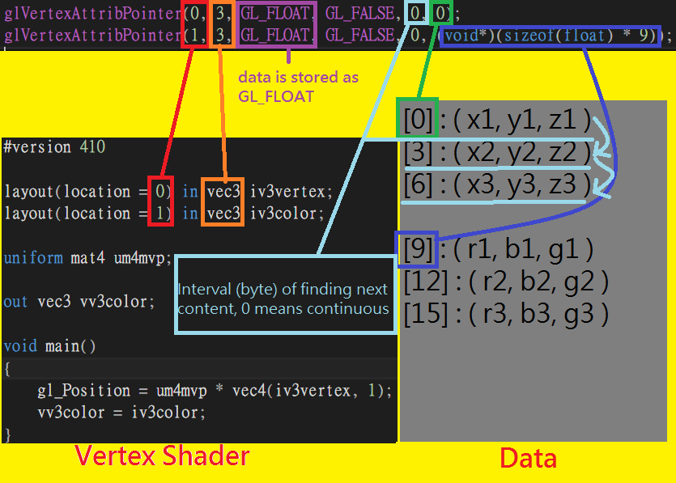
Step – Main display loop (Rendering)

Slide 15
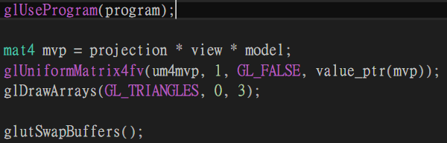
Step – Main display loop (Rendering)
Tell openGL which shader program to use by glUseProgram(program_id)
Compute MVP matrix and send it to those shaders with uniform variable called ‘um4mvp’ by calling glUniformMatrix4fv
Render primitives from array data by calling glDrawArrays
Swap buffer to clear previous frame and display new frame by calling glutSwapBuffers();

Slide 16
Objective
Rotate object with different speed
Change rotation speed by menu events ( Slow/Fast )
Control translate by keyboard event ( A/D/W/S )

Slide 17
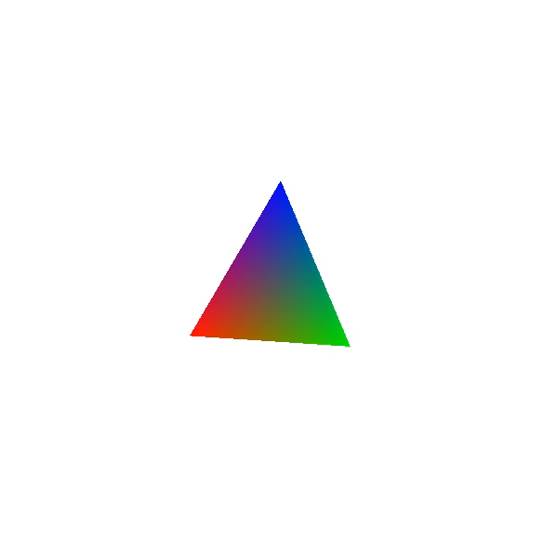
Objective

Slide 18
Hint
There are 8 TODOs in the code
Search “TODO” if you don’t know how to start

